Slide 1


Student Performance Indicator (SPI)
An End-to-End Machine Learning Project
Presented by: Sharada Sonaje | Data Science Intern
Tools: Python | Scikit-Learn | Flask | VS Code | AWS
by Sharada Sonaje

Slide 2

Project Objective: Predicting Math Scores
Goal
To build and deploy a Machine Learning model that predicts a student’s math score based on demographic and academic features.
Why?
Enable data-driven academic interventions and student performance monitoring, fostering personalized learning paths.
By leveraging predictive analytics, we aim to provide educators and students with actionable insights to proactively address learning challenges and optimize educational outcomes.

Slide 3
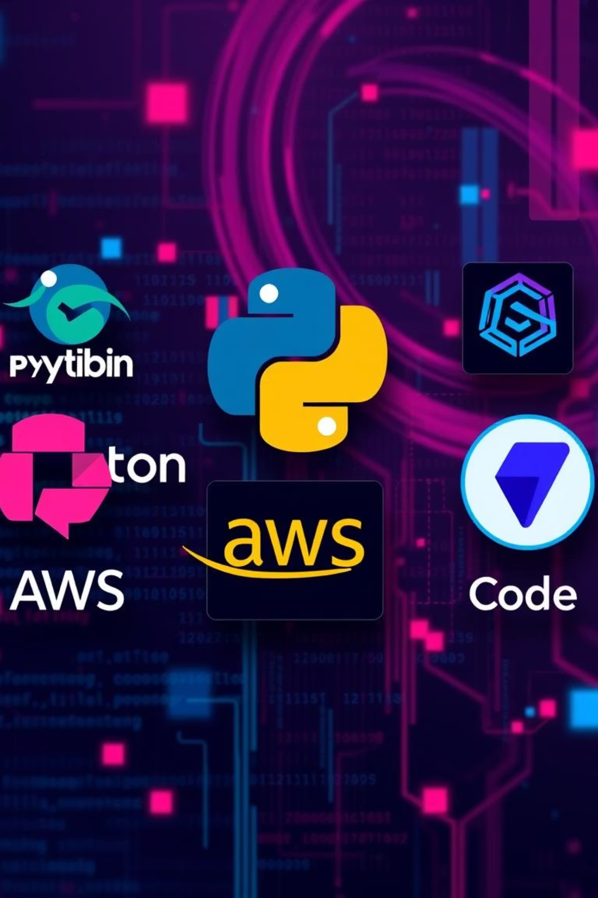




Core Technology Stack
IDE & Language
VS Code for development and Python for robust scripting.
Libraries
pandas, numpy for data manipulation, sklearn, xgboost, and dill for ML.
Framework & Cloud
Flask for web application and AWS Elastic Beanstalk for deployment.
Version Control
Git and GitHub for collaborative development and code management.

Slide 4







Project Workflow: From Data to Deployment
Problem Understanding
Defining the scope and objectives of the prediction task.
EDA & Data Preprocessing
Exploring data patterns and preparing it for model training, handling missing values and outliers.
Data Ingestion
Automating the loading and splitting of raw data for training and testing.
Data Transformation
Applying various transformations like scaling and encoding to features.
Model Training & Evaluation
Training multiple models and assessing their performance rigorously.
Deployment via Flask
Making the trained model accessible through a web API.
Live Predictions from HTML UI
Enabling users to input data and receive real-time predictions through a user-friendly interface.

Slide 5
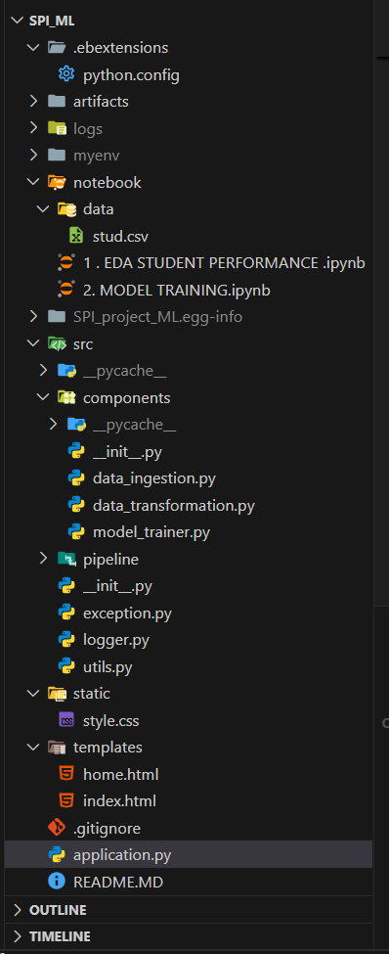
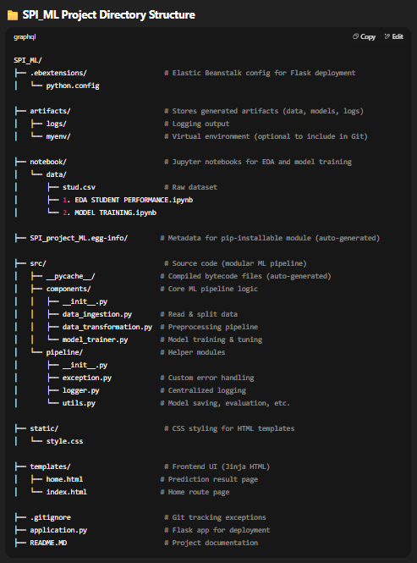
Project Directory Structure
This structured layout ensures modularity, maintainability, and scalability for the entire machine learning pipeline, separating concerns from data to deployment.

Slide 6
Data Ingestion: src/components/data_ingestion.py
Reads Raw Data
Creates Artifacts Folder
Saves Data Splits
Initializes by reading the raw student performance data from a CSV file, serving as the primary input.
Automatically sets up the 'artifacts/' directory to store all processed data and models.
Persists raw, training, and testing datasets as separate CSV files within the 'artifacts/' folder for reproducibility.
Utilizes Scikit-learn
Logs Every Step
Employs the train_test_split() function for efficient data split.
Integrates logger.py to meticulously log each stage of the data ingestion process, ensuring traceability.

Slide 7
Data Transformation: src/components/data_transformation.py
Numerical Pipeline
Categorical Pipeline
Numerical features undergo a robust preprocessing sequence to handle missing values and standardize their scale:
Categorical features are processed to convert them into a machine learning-friendly format:
Median Imputer: Replaces missing numerical values with the median to mitigate outlier influence.
Most Frequent Imputer: Fills missing categorical values with the mode, preserving common categories.
StandardScaler: Transforms features to have zero mean and unit variance, crucial for many ML algorithms.
OneHotEncoder: Converts categorical variables into a binary (dummy) representation, preventing ordinal misinterpretation.
The transformed numerical and categorical arrays are then combined, and the entire preprocessor object is saved using pickle for consistent future use.

Slide 8

Model Training: src/components/model_trainer.py
Multiple Models Trained
The module systematically trains a suite of regression models to identify the best performer, including: Linear Regression, Random Forest, XGBoost, and AdaBoost.
Hyperparameter Tuning
Utilizes GridSearchCV for comprehensive hyperparameter tuning, ensuring optimal model configurations.
Performance Evaluation
Models are rigorously evaluated using the R² Score to measure their predictive accuracy and goodness of fit.
Best Model Persistence
The top-performing model, if its R² score exceeds 0.6, is saved to ensure future reusability and deployment readiness.

Slide 9
Utility Modules: Enhancing Efficiency
utils.py
exception.py
save_object(): Facilitates the serialization and saving of trained models and preprocessors to disk.
Custom Exception Handler: Provides a robust mechanism for managing and logging custom exceptions.
load_object(): Enables easy deserialization and loading of saved Python objects.
Traceback Integration: Ensures detailed error reporting with comprehensive traceback information for debugging.
evaluate_models(): A helper function designed to streamline the evaluation process across multiple models.
logger.py
Pipeline Step Logging: Records every significant event throughout the ML pipeline.
Timestamping: Attaches precise timestamps to logs for accurate chronological tracking of operations.

Slide 10
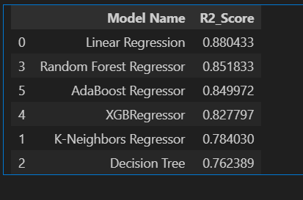
Model Evaluation & Selection
The XGBoost model demonstrates superior performance with an R² score of 0.85, making it the optimal choice for predicting student math scores. This model has been saved as artifacts/model.pkl for deployment.

Slide 11
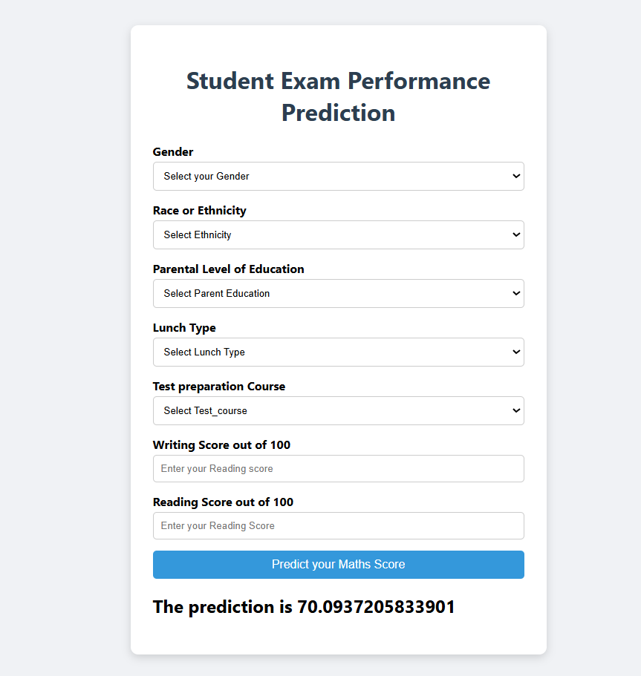
Web Interface Snapshot

